Slide 1
DBMS Cornerstone Project
Student Hostel Management System
Automated Room Allocation & Fee Tracking
Nunna Sai Sri Laxmi · 25B11CS682
Kamuju Sree Reshma Laxmi · 25B11CS385
Bheemireddy Aswini · 25B11CS107
Medepalli Akshaya Keerthana · 25B11CS592

Slide 2
Agenda
Problem statement & requirement analysis
Objectives
Functional & non-functional requirements
End users
ER design — entities, attributes, keys
Relationships & cardinality
Normalization — 1NF, 2NF, 3NF
SQL implementation — DDL, data & queries
Anticipated questions

Slide 3
The Real-World Problem
Why manual hostel administration breaks down
Room allocation errors — Manual assignment without a real-time occupancy check leads to overbooking or beds wrongly marked free.
Delayed fee tracking — Dues are noted on paper with no single source of truth — defaulters are caught too late.
Untracked complaints — Complaints are logged informally with no defined status, so resolution isn't guaranteed.
No visitor record — Walk-in visitors go unlogged — an administrative gap and a security risk.

Slide 4
Why This Project Is Needed
Justification
Manual systems don't scale — error rates in allocation and fee reconciliation grow with hostel strength.
A centralised database removes duplicate/inconsistent records via primary keys, foreign keys, and 3NF normalization.
Gives the warden/admin a live, queryable picture of occupancy, dues, and complaint backlog — not a static paper trail.
Creates an audit trail (who paid what and when, who visited whom and when) that manual logs cannot guarantee.

Slide 5
Objectives
Automate student registration with a single authoritative record
Automate room allotment based on real-time capacity & availability
Track fee payments with due dates and live status
Structured complaint workflow: Open → In Progress → Resolved
Maintain a visitor log for accountability & security
Normalize schema to 3NF; automate via joins, aggregates, triggers

Slide 6
Requirements
Functional
Register, update, search students
Auto-allot rooms; update occupancy
Record fee payments & status
File & track complaints to resolution
Log visitor entry / exit
Generate reports via joins & aggregates
Triggers keep room status consistent
Non-functional
Data integrity — PK/FK, CHECK, UNIQUE constraints
Security — role-based access for wardens vs students
Reliability during peak periods (admissions, dues)
Performance on availability & fee-status lookups
Usability for non-technical hostel staff
Scalability as blocks, rooms, students grow

Slide 7
End Users
User | Interacts with the system to…
Hostel Warden / Admin | Register students, allot rooms, update complaints, verify fees, generate reports
Students | View room, fee status, complaint status; file new complaints
Accounts / Fee office staff | Record fee payments and track dues
Security / Gate staff | Log visitor entries and exits
System Administrator | Manage user accounts, backups, configuration

Slide 8
Relational Schema
Six tables mapped from the ER model — underlined = primary key, FK = foreign key
Warden (Warden_ID, Name, Contact_No, Block_Assigned)
Room (Room_ID, Room_No, Block, Capacity, Occupied_Count, Status, Warden_ID(FK))
Student (Student_ID, Name, Contact_No, Email, Room_ID(FK))
Fee_Payment(Payment_ID, Student_ID(FK), Amount, Due_Date, Payment_Date, Status)
Complaint (Complaint_ID, Student_ID(FK), Warden_ID(FK), Description, Status, Date_Filed)
Visitor(Visitor_ID, Student_ID(FK), Name, Contact_No, Visit_Date, Purpose)

Slide 9
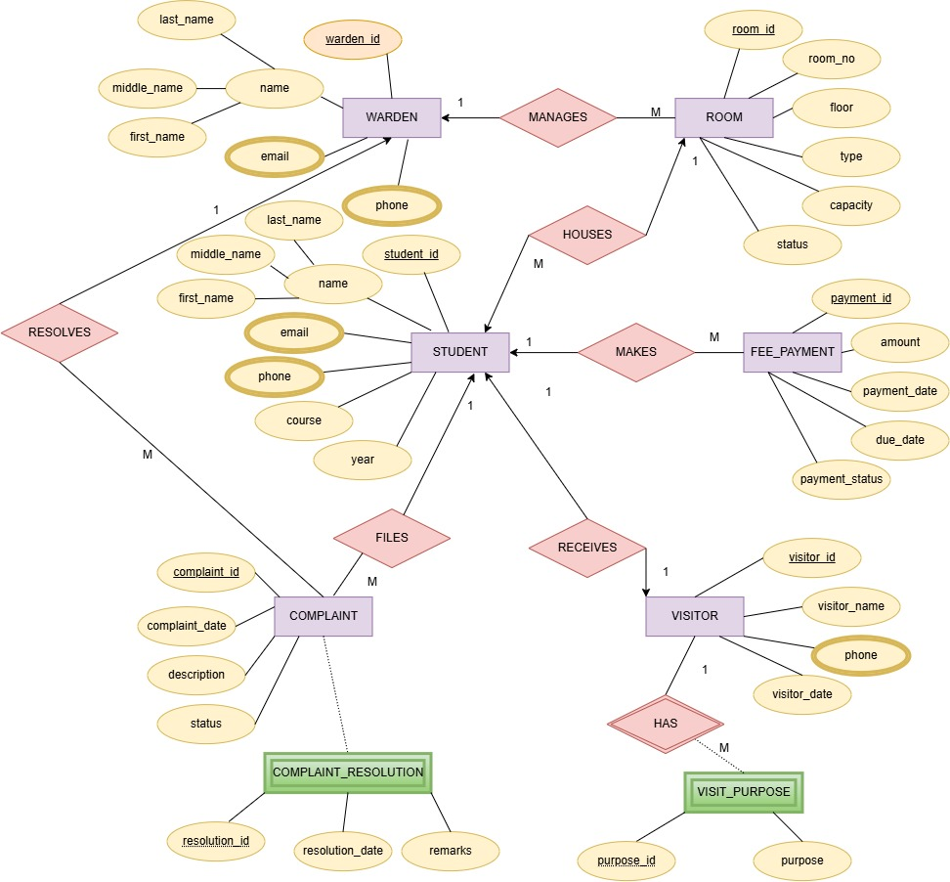
Entity-Relationship Diagram
Link:https://drive.google.com/file/d/1-T-Qv0u7PWdYSrMmEYHmQOtL0HpfTMlF/view?usp=sharing

Slide 10
Relationships & Cardinality
Relationship | Cardinality | Justification
Room — Student (“houses”) | 1:M | One room holds multiple students up to Capacity; each student is allotted one room. FK sits on Student.
Warden — Room (“manages”) | 1:M | One warden is assigned a block, i.e. many rooms; a room has one warden at a time.
Student — Fee_Payment (“makes”) | 1:M | A student pays across multiple installments; each payment ties to one student.
Student — Complaint (“files”) | 1:M | A student may raise several complaints; each belongs to one student.
Warden — Complaint (“resolves”) | 1:M | A warden handles many complaints; each is resolved by one warden.
Student — Visitor (“receives”) | 1:1 | A student visits one person at a time at different time slots.

Slide 11
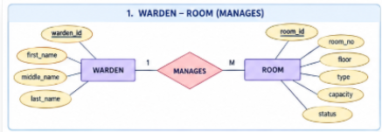
SQL Table Creation (DDL)
13 tables total: 6 core entities, 5 attribute tables, 2 relationship tables — 8 foreign keys tie them together
1. WARDEN — ROOM
Relationship: MANAGES (1:M)
Core entity — warden
CREATE TABLE warden (
warden_id INTEGER,
first_name VARCHAR2(30),
middle_name VARCHAR2(30),
last_name VARCHAR2(30),
CONSTRAINT warden_pk
PRIMARY KEY (warden_id)
);
Core entity — room
CREATE TABLE room (
room_id INTEGER,
room_no INTEGER,
floor INTEGER,
type VARCHAR2(20),
capacity INTEGER,
status NUMBER(1),
warden_id INTEGER,
CONSTRAINT room_pk
PRIMARY KEY (room_id)
);
ALTER TABLE room ADD
CONSTRAINT room_warden_fk
FOREIGN KEY (warden_id)
REFERENCES warden(warden_id);

Slide 12
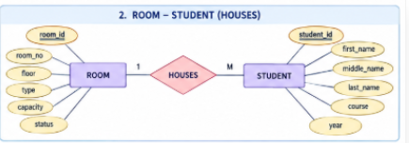
SQL Table Creation (DDL)
13 tables total: 6 core entities, 5 attribute tables, 2 relationship tables — 8 foreign keys tie them together
2. ROOM — STUDENT
Relationship: HOUSES (1:M)
Core entity — room
CREATE TABLE room (
room_id INTEGER,
room_no INTEGER,
floor INTEGER,
type VARCHAR2(20),
capacity INTEGER,
status NUMBER(1),
warden_id INTEGER,
CONSTRAINT room_pk
PRIMARY KEY (room_id)
);
Core entity — student
CREATE TABLE student (
student_id INTEGER,
first_name VARCHAR2(30),
middle_name VARCHAR2(30),
last_name VARCHAR2(30),
course VARCHAR2(30),
year INTEGER,
room_id INTEGER,
CONSTRAINT student_pk
PRIMARY KEY (student_id)
);
ALTER TABLE student ADD
CONSTRAINT student_room_fk
FOREIGN KEY (room_id)
REFERENCES room(room_id);

Slide 13
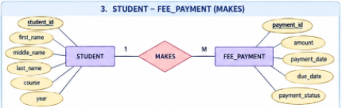
SQL Table Creation (DDL)
13 tables total: 6 core entities, 5 attribute tables, 2 relationship tables — 8 foreign keys tie them together
3. STUDENT — FEE_PAYMENT
Relationship: MAKES (1:M)
Core entity — student
CREATE TABLE student (
student_id INTEGER,
first_name VARCHAR2(30),
middle_name VARCHAR2(30),
last_name VARCHAR2(30),
course VARCHAR2(30),
year INTEGER,
room_id INTEGER,
CONSTRAINT student_pk
PRIMARY KEY (student_id)
);
Core entity — fee_payment
CREATE TABLE fee_payment (
payment_id INTEGER,
amount INTEGER,
payment_date DATE,
due_date DATE,
payment_status NUMBER(1),
student_id INTEGER,
CONSTRAINT fee_payment_pk
PRIMARY KEY (payment_id)
);
ALTER TABLE fee_payment ADD
CONSTRAINT payment_student_fk
FOREIGN KEY (student_id)
REFERENCES student(student_id);

Slide 14
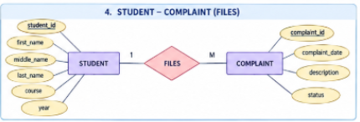
SQL Table Creation (DDL)
13 tables total: 6 core entities, 5 attribute tables, 2 relationship tables — 8 foreign keys tie them together
4. STUDENT — COMPLAINT
Relationship: FILES (1:M)
Core entity — student
CREATE TABLE student (
student_id INTEGER,
first_name VARCHAR2(30),
middle_name VARCHAR2(30),
last_name VARCHAR2(30),
course VARCHAR2(30),
year INTEGER,
room_id INTEGER,
CONSTRAINT student_pk
PRIMARY KEY (student_id)
);
Core entity — complaint
CREATE TABLE complaint (
complaint_id INTEGER,
complaint_date DATE,
description VARCHAR2(100),
status NUMBER(1),
student_id INTEGER,
warden_id INTEGER,
CONSTRAINT complaint_pk
PRIMARY KEY (complaint_id)
);
ALTER TABLE complaint ADD
CONSTRAINT complaint_student_fk
FOREIGN KEY (student_id)
REFERENCES student(student_id);

Slide 15
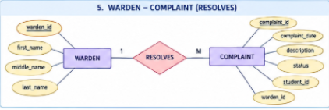
SQL Table Creation (DDL)
13 tables total: 6 core entities, 5 attribute tables, 2 relationship tables — 8 foreign keys tie them together
5. WARDEN — COMPLAINT
Relationship: RESOLVES (1:M)
Core entity — warden
CREATE TABLE warden (
warden_id INTEGER,
first_name VARCHAR2(30),
middle_name VARCHAR2(30),
last_name VARCHAR2(30),
CONSTRAINT warden_pk
PRIMARY KEY (warden_id)
);
Core entity — complaint
CREATE TABLE complaint (
complaint_id INTEGER,
complaint_date DATE,
description VARCHAR2(100),
status NUMBER(1),
student_id INTEGER,
warden_id INTEGER,
CONSTRAINT complaint_pk
PRIMARY KEY (complaint_id)
);
ALTER TABLE complaint ADD
CONSTRAINT complaint_warden_fk
FOREIGN KEY (warden_id)
REFERENCES warden(warden_id);

Slide 16
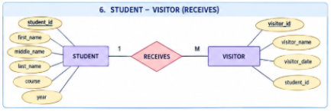
SQL Table Creation (DDL)
13 tables total: 6 core entities, 5 attribute tables, 2 relationship tables — 8 foreign keys tie them together
6. STUDENT — VISITOR
Relationship: RECEIVES (1:1)
Core entity — student
CREATE TABLE student (
student_id INTEGER,
first_name VARCHAR2(30),
middle_name VARCHAR2(30),
last_name VARCHAR2(30),
course VARCHAR2(30),
year INTEGER,
room_id INTEGER,
CONSTRAINT student_pk
PRIMARY KEY (student_id)
);
Core entity — visitor
CREATE TABLE visitor (
visitor_id INTEGER,
visitor_name VARCHAR2(30),
visitor_date DATE,
student_id INTEGER,
CONSTRAINT visitor_pk
PRIMARY KEY (visitor_id)
);
ALTER TABLE visitor ADD
CONSTRAINT visitor_student_fk
FOREIGN KEY (student_id)
REFERENCES student(student_id);
ALTER TABLE visitor ADD
CONSTRAINT visitor_student_uk
UNIQUE (student_id);

Slide 17
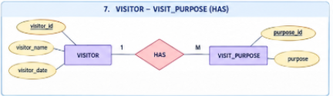
SQL Table Creation (DDL)
13 tables total: 6 core entities, 5 attribute tables, 2 relationship tables — 8 foreign keys tie them together
7. VISITOR — VISIT_PURPOSE
Relationship: HAS (1:M)
Core entity — visitor
CREATE TABLE visitor (
visitor_id INTEGER,
visitor_name VARCHAR2(30),
visitor_date DATE,
student_id INTEGER,
CONSTRAINT visitor_pk
PRIMARY KEY (visitor_id)
);
Core entity — visit_purpose
CREATE TABLE visit_purpose (
visitor_id INTEGER,
purpose_id INTEGER,
purpose VARCHAR2(50),
CONSTRAINT visit_purpose_pk
PRIMARY KEY (visitor_id, purpose_id),
CONSTRAINT visit_purpose_fk
FOREIGN KEY (visitor_id)
REFERENCES visitor(visitor_id)
);

Slide 18
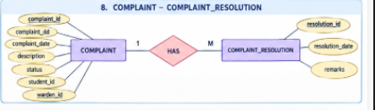
SQL Table Creation (DDL)
13 tables total: 6 core entities, 5 attribute tables, 2 relationship tables — 8 foreign keys tie them together
8. COMPLAINT — COMPLAINT_RESOLUTION
Relationship: HAS (1:M)
Core entity —complaint
CREATE TABLE complaint (
complaint_id INTEGER,
complaint_date DATE,
description VARCHAR2(100),
status NUMBER(1),
student_id INTEGER,
warden_id INTEGER,
CONSTRAINT complaint_pk
PRIMARY KEY (complaint_id)
);
Core entity — complaint_resolution
CREATE TABLE complaint_resolution (
complaint_id INTEGER,
resolution_id INTEGER,
resolution_date DATE,
remarks VARCHAR2(100),
CONSTRAINT complaint_resolution_pk
PRIMARY KEY (complaint_id, resolution_id),
CONSTRAINT complaint_resolution_fk
FOREIGN KEY (complaint_id)
REFERENCES complaint(complaint_id)
);

Slide 19
Query 1 — All Students
Q: Display the complete student register held by the hostel.
SQL query
SELECT *
FROM student;
Concepts used
Simple projection of a single table
Baseline check that the INSERT data loaded
Output
STUDENT_ID FIRST_NAME LAST_NAME COURSE YEAR ROOM_ID
---------- ---------- --------- ------ ---- -------
201 Sai Laxmi CSE 2 101
202 Rahul Reddy CSE 2 102
203 Priya Rao AIML 2 103
204 Ravi Das IT 1 104
205 Sita Patel CSE 1 105
206 Arjun Singh ECE 2 106
207 Sneha Gupta CSE 2 107
208 Kiran Rao IT 1 108
209 Pooja Nair AIML 3 109
210 Vijay Mishra CSE 3 110
211 Divya Jain ECE 2 111
15 rows selected.

Slide 20
Query 2 — Student With Room
Q: Show each student together with the room they have been allotted.
SQL query
SELECT s.student_id,
s.first_name || ' ' || s.last_name
AS student_name,
r.room_no, r.floor, r.type
FROM student s
JOIN room r
ON s.room_id = r.room_id;
Concepts used
INNER JOIN across the student_room FK
String concatenation with || and an alias
Output
STUDENT_ID STUDENT_NAME ROOM_NO FLOOR TYPE
---------- ------------ ------- ----- ------
201 Sai Laxmi 1 1 Single
202 Rahul Reddy 2 1 Double
203 Priya Rao 3 1 Double
204 Ravi Das 4 1 Triple
205 Sita Patel 5 1 Single
206 Arjun Singh 6 2 Double
207 Sneha Gupta 7 2 Triple
208 Kiran Rao 8 2 Single
209 Pooja Nair 9 2 Double
210 Vijay Mishra 10 2 Triple
211 Divya Jain 11 3 Single
15 rows selected.

Slide 21
Query 3 — Students of One Branch
Q: Which students belong to the CSE branch?
SQL query
SELECT student_id, first_name, last_name,
course, year
FROM student
WHERE course = 'CSE';
Concepts used
WHERE filter on a character column
Returns 7 of the 15 students
Output
STUDENT_ID FIRST_NAME LAST_NAME COURSE YEAR
---------- ---------- --------- ------ ----
201 Sai Laxmi CSE 2
202 Rahul Reddy CSE 2
205 Sita Patel CSE 1
207 Sneha Gupta CSE 2
210 Vijay Mishra CSE 3
212 Amit Shah CSE 1
214 Manoj Rao CSE 2
7 rows selected.

Slide 22
Query 4 — Rooms Per Warden
Q: Which rooms does each warden supervise?
SQL query
SELECT w.warden_id,
w.first_name || ' ' || w.last_name
AS warden_name,
r.room_no, r.floor, r.type
FROM warden w
JOIN room r
ON w.warden_id = r.warden_id
ORDER BY w.warden_id;
Concepts used
Join on the room_warden FK
ORDER BY groups a warden's rooms together
Output
WARDEN_ID WARDEN_NAME ROOM_NO FLOOR TYPE
--------- ------------ ------- ----- ------
1 Ravi Sharma 1 1 Single
1 Ravi Sharma 2 1 Double
2 Anil Verma 3 1 Double
2 Anil Verma 4 1 Triple
3 Suresh Reddy 5 1 Single
3 Suresh Reddy 6 2 Double
4 Priya Rao 7 2 Triple
4 Priya Rao 8 2 Single
5 Kiran Patel 9 2 Double
5 Kiran Patel 10 2 Triple
6 Arjun Singh 11 3 Single
15 rows selected.

Slide 23
Query 5 — Students Who Have Paid
Q: List the students whose hostel fee has been received.
SQL query
SELECT s.student_id,
s.first_name || ' ' || s.last_name
AS student_name,
f.amount, f.payment_date
FROM student s
JOIN fee_payment f
ON s.student_id = f.student_id
WHERE f.payment_status = 1;
Concepts used
JOIN plus WHERE on a status flag
13 of 15 students have cleared the fee
Output
STUDENT_ID STUDENT_NAME AMOUNT PAYMENT_DATE
---------- ------------ ------ ------------
201 Sai Laxmi 25000 2026-01-05
202 Rahul Reddy 25000 2026-01-06
203 Priya Rao 26000 2026-01-07
204 Ravi Das 24000 2026-01-08
205 Sita Patel 25000 2026-01-09
206 Arjun Singh 27000 2026-01-10
207 Sneha Gupta 26000 2026-01-11
208 Kiran Rao 24000 2026-01-12
209 Pooja Nair 25000 2026-01-13
210 Vijay Mishra 27000 2026-01-14
211 Divya Jain 25000 2026-01-16
13 rows selected.

Slide 24
Query 6 — Pending Fee Payments
Q: Who still owes the hostel fee, and by what due date?
SQL query
SELECT s.student_id,
s.first_name || ' ' || s.last_name
AS student_name,
f.amount, f.due_date
FROM student s
JOIN fee_payment f
ON s.student_id = f.student_id
WHERE f.payment_status = 0;
Concepts used
The defaulter report the warden needs
Same join, opposite status value
Output
STUDENT_ID STUDENT_NAME AMOUNT DUE_DATE
---------- ------------ ------ ----------
214 Manoj Rao 25000 2026-01-20
215 Anu Kumar 27000 2026-01-25
2 rows selected.

Slide 25
Query 7 — Complaint Detail
Q: Show every complaint with who raised it and who is handling it.
SQL query
SELECT c.complaint_id,
s.first_name || ' ' || s.last_name
AS student_name,
c.description, c.status,
w.first_name || ' ' || w.last_name
AS warden_name
FROM complaint c
JOIN student s
ON c.student_id = s.student_id
JOIN warden w
ON c.warden_id = w.warden_id;
Concepts used
Three-table join
status 1 = resolved, 0 = open
Output
COMPLAINT_ID STUDENT_NAME DESCRIPTION STATUS WARDEN_NAME
------------ ------------ --------------- ------ ------------
401 Sai Laxmi Water problem 1 Ravi Sharma
402 Rahul Reddy Fan not working 1 Anil Verma
403 Priya Rao Light problem 1 Suresh Reddy
404 Ravi Das WiFi issue 0 Priya Rao
405 Sita Patel Room cleaning 1 Kiran Patel
406 Arjun Singh Bathroom issue 1 Arjun Singh
407 Sneha Gupta Bed repair 0 Meena Das
408 Kiran Rao Door lock issue 1 Rahul Naik
409 Pooja Nair Water leakage 1 Sneha Gupta
410 Vijay Mishra AC problem 0 Vijay Mishra
411 Divya Jain Mess food issue 1 Pooja Nair
15 rows selected.

Slide 26
Query 8 — Open Complaints
Q: Which complaints are still open?
SQL query
SELECT complaint_id, student_id,
description, complaint_date
FROM complaint
WHERE status = 0;
Concepts used
Single-table WHERE on the status flag
4 complaints remain open
Output
COMPLAINT_ID STUDENT_ID DESCRIPTION COMPLAINT_DATE
------------ ---------- --------------- --------------
404 204 WiFi issue 2026-02-04
407 207 Bed repair 2026-02-07
410 210 AC problem 2026-02-10
413 213 Furniture issue 2026-02-13
4 rows selected.

Slide 27
Query 9 — Students Per Room
Q: How many students currently occupy each room?
SQL query
SELECT r.room_no, r.capacity,
COUNT(s.student_id) AS students_count
FROM room r
LEFT JOIN student s
ON r.room_id = s.room_id
GROUP BY r.room_no, r.capacity
ORDER BY r.room_no;
Concepts used
LEFT JOIN keeps empty rooms in the result
COUNT with GROUP BY on two columns
Output
ROOM_NO CAPACITY STUDENTS_COUNT
------- -------- --------------
1 1 1
2 2 1
3 2 1
4 3 1
5 1 1
6 2 1
7 3 1
8 1 1
9 2 1
10 3 1
11 1 1
15 rows selected.

Slide 28
Query 10 — Rooms With Free Beds
Q: Which rooms still have a bed free for a new admission?
SQL query
SELECT r.room_no, r.capacity,
COUNT(s.student_id) AS occupied,
r.capacity - COUNT(s.student_id)
AS available
FROM room r
LEFT JOIN student s
ON r.room_id = s.room_id
GROUP BY r.room_no, r.capacity
HAVING COUNT(s.student_id) < r.capacity;
Concepts used
HAVING filters groups, WHERE cannot
Drives the automated room-allotment rule
Output
ROOM_NO CAPACITY OCCUPIED AVAILABLE
------- -------- -------- ---------
2 2 1 1
3 2 1 1
4 3 1 2
6 2 1 1
7 3 1 2
9 2 1 1
10 3 1 2
12 2 1 1
13 3 1 2
15 2 1 1
10 rows selected.

Slide 29
Query 11 — Students Per Course
Q: How is hostel strength distributed across branches?
SQL query
SELECT course,
COUNT(*) AS total_students
FROM student
GROUP BY course
ORDER BY total_students DESC;
Concepts used
Aggregate over one table
ORDER BY on the aggregate alias
Output
COURSE TOTAL_STUDENTS
------ --------------
CSE 7
IT 3
AIML 3
ECE 2
4 rows selected.

Slide 30
Query 12 — Total Fee Collected
Q: What is the total amount collected so far?
SQL query
SELECT SUM(amount) AS total_fee_collected
FROM fee_payment
WHERE payment_status = 1;
Concepts used
SUM over the rows that passed the filter
13 paid rows total 3,29,000
Outstanding dues: 52,000 across 2 students
Output
TOTAL_FEE_COLLECTED
-------------------
329000
1 row selected.

Slide 31
Query 13 — Visitor Log
Q: Who visited the hostel, on what date, and to see whom?
SQL query
SELECT v.visitor_id, v.visitor_name,
v.visitor_date,
s.first_name || ' ' || s.last_name
AS student_name
FROM visitor v
JOIN student s
ON v.student_id = s.student_id
ORDER BY v.visitor_date;
Concepts used
Join on the visitor_student FK
Chronological security log
Output
VISITOR_ID VISITOR_NAME VISITOR_DATE STUDENT_NAME
---------- ------------ ------------ ------------
501 Ramesh 2026-02-01 Sai Laxmi
502 Suresh 2026-02-02 Rahul Reddy
503 Kavya 2026-02-03 Priya Rao
504 Anil 2026-02-04 Ravi Das
505 Pavan 2026-02-05 Sita Patel
506 Meena 2026-02-06 Arjun Singh
507 Rohit 2026-02-07 Sneha Gupta
508 Swathi 2026-02-08 Kiran Rao
509 Arun 2026-02-09 Pooja Nair
510 Divya 2026-02-10 Vijay Mishra
511 Kiran 2026-02-11 Divya Jain
15 rows selected.

Slide 32
Query 14 — Visitors Per Student
Q: How many visitors has each student received?
SQL query
SELECT s.student_id,
s.first_name || ' ' || s.last_name
AS student_name,
COUNT(v.visitor_id) AS visitor_count
FROM student s
JOIN visitor v
ON s.student_id = v.student_id
GROUP BY s.student_id,
s.first_name, s.last_name
ORDER BY visitor_count DESC;
Concepts used
COUNT per group with a descending sort
Every student has one logged visitor
Output
STUDENT_ID STUDENT_NAME VISITOR_COUNT
---------- ------------ -------------
215 Anu Kumar 1
214 Manoj Rao 1
213 Swathi Reddy 1
212 Amit Shah 1
211 Divya Jain 1
210 Vijay Mishra 1
209 Pooja Nair 1
208 Kiran Rao 1
207 Sneha Gupta 1
206 Arjun Singh 1
205 Sita Patel 1
15 rows selected.

Slide 33
Query 15 — Complaint Resolutions
Q: How was each complaint finally resolved?
SQL query
SELECT c.complaint_id, c.description,
cr.resolution_date, cr.remarks
FROM complaint c
JOIN complaint_resolution cr
ON c.complaint_id = cr.complaint_id
ORDER BY cr.resolution_date;
Concepts used
Joins the 1NF relationship table
Closes the complaint workflow loop
Output
COMPLAINT_ID DESCRIPTION RESOLUTION_DATE REMARKS
------------ --------------- --------------- -----------------
401 Water problem 2026-02-02 Water repaired
402 Fan not working 2026-02-03 Fan replaced
403 Light problem 2026-02-04 Light replaced
404 WiFi issue 2026-02-05 WiFi fixed
405 Room cleaning 2026-02-06 Room cleaned
406 Bathroom issue 2026-02-07 Bathroom repaired
407 Bed repair 2026-02-08 Bed repaired
408 Door lock issue 2026-02-09 Lock replaced
409 Water leakage 2026-02-10 Leakage fixed
410 AC problem 2026-02-11 AC repaired
411 Mess food issue 2026-02-12 Issue resolved
15 rows selected.

Slide 34
Normalization — Before & The Problem
Start with one flat table: repeated data creates redundancy and anomalies.
BEFORE — UNNORMALIZED (UNF)
WHAT GOES WRONG
HOSTEL_RECORD(
student_id, student_name, phone1, phone2,
room_no, room_type, capacity, warden_id,
warden_name, warden_phone, amount, due_date, payment_status)
REDUNDANCY
Ravi Sharma and room facts are repeated across student rows.
SID | Student | Phone1 / Phone2 | Room | Warden | Fee
201 | Sai Laxmi | 9100000001 / 02 | 1 | Ravi Sharma | 25000
202 | Rahul Reddy | 9100000002 | 2 | Ravi Sharma | 25000
214 | Manoj Rao | 9100000014 | 14 | Ravi Sharma | 27000
INSERTION ANOMALY
A new room cannot be stored until a student exists.
UPDATE ANOMALY
Change one warden phone → many rows must be updated.
DELETION ANOMALY
Delete the last student → room information can disappear.
26-09-2026
DBMS Cornerstone Project • Student Hostel Management System
11

Slide 35
1NF — Atomic Values
Remove repeating groups and make every attribute single-valued.
BEFORE — SCHEMA + SAMPLE
AFTER — 1NF TABLES
Student(student_id, name, phone1, phone2, email)
Problem: phone1/phone2 is a repeating group.
Student(student_id, first_name, middle_name,
last_name, course, year, room_id)
student_id | name | phone1 | phone2
201 | Sai Laxmi | 9100000001 | 9100000002
202 | Rahul Reddy | 9100000003 | —
Student_Phone(student_id FK, phone)
student_id | phone
201 | 9100000001
201 | 9100000002
202 | 9100000003
A third phone would require changing the table structure.
Student_Email(student_id FK, email)
Each value is atomic; phones can grow without schema changes.
26-09-2026
DBMS Cornerstone Project • Student Hostel Management System
12

Slide 36
2NF — No Partial Dependency
1NF + every non-key attribute depends on the whole primary key.
AFTER — 2NF TABLES
BEFORE — PARTIAL DEPENDENCY
Student(student_id, first_name, ..., course)
Fee_Payment(payment_id, amount, payment_date,
due_date, payment_status, student_id FK)
Fee_Detail(student_id, payment_id,
student_name, course, amount, payment_date)
PK = (student_id, payment_id)
payment_id | student_id | amount | status
301 | 201 | 25000 | 1
302 | 201 | 25000 | 1
student_name and course depend only on student_id → partial dependency.
student_id | payment_id | student_name | course | amount
201 | 301 | Sai Laxmi | CSE | 25000
201 | 302 | Sai Laxmi | CSE | 25000
student_id | student_name | course
201 | Sai Laxmi | CSE
26-09-2026
DBMS Cornerstone Project • Student Hostel Management System
13

Slide 37
3NF — No Transitive Dependency
2NF + non-key attributes depend only on the primary key.
BEFORE — SCHEMA
AFTER — 3NF TABLES
Room(room_id, room_no, floor, type,
capacity, status, warden_id,
warden_name, warden_phone)
Room(room_id, room_no, floor, type,
capacity, status, warden_id FK)
room_id → warden_id → warden_name / warden_phone
This is a transitive dependency.
room_id | room_no | warden_id
101 | 1 | 1
102 | 2 | 1
room_id | room_no | warden_id | warden_name
101 | 1 | 1 | Ravi Sharma
102 | 2 | 1 | Ravi Sharma
Warden(warden_id, first_name, middle_name, last_name)
warden_id | first_name | last_name
1 | Ravi | Sharma
26-09-2026
DBMS Cornerstone Project • Student Hostel Management System
14

Slide 38
Final Normalized Schema — 3NF
The decomposition removes redundancy while preserving relationships through primary and foreign keys.
BEFORE — FLAT SCHEMA
AFTER — 3NF SCHEMA
HOSTEL_RECORD
Student + Phone + Room + Warden + Fee
all stored together
→ repeated names
→ repeated room facts
→ anomalies
Warden (warden_id, first_name, middle_name, last_name)
Room (room_id, room_no, floor, type, capacity, status, warden_id FK)
Student (student_id, first_name, middle_name, last_name, course, year, room_id FK)
Fee_Payment (payment_id, amount, payment_date, due_date, payment_status, student_id FK)
Complaint (complaint_id, complaint_date, description, status, student_id FK, warden_id FK)
Visitor (visitor_id, visitor_name, visitor_date, student_id FK)
Student_Phone / Student_Email / Warden_Phone / Warden_Email
Visitor_Phone / Complaint_Resolution / Visit_Purpose
Result: redundancy ↓ • anomalies removed
13 tables • PK/FK relationships enforce referential integrity
26-09-2026
DBMS Cornerstone Project • Student Hostel Management System
15

Slide 39
Thank You
Questions welcome

